Slide 1

From Zero to Hero:
2021.12.03
Contribution Guidebook for OpenStack Beginners
Presenter : Seung Tae Kim

Slide 2
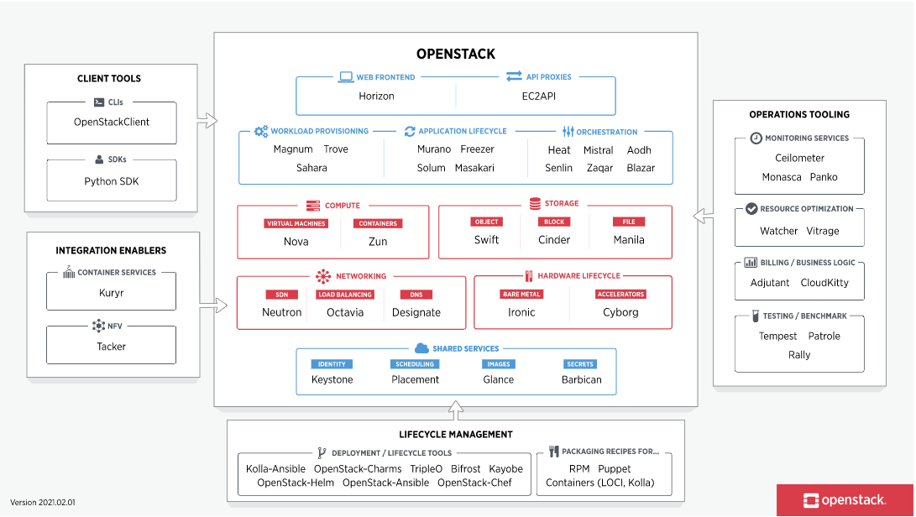
Openstack is a huge project that combines multiple components.
It basically consists of 6 core & 30 additional components independently.

Slide 3
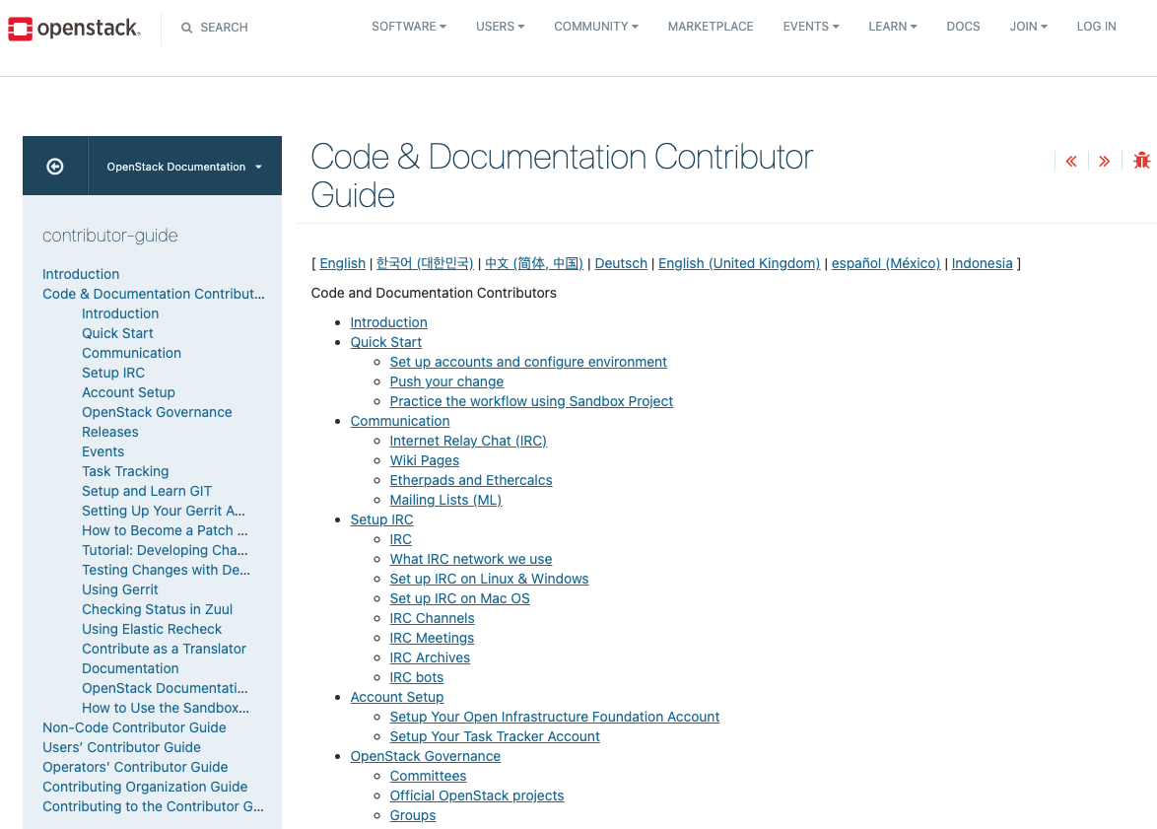
It is an official account & contribution guide for those who are new to OpenStack.
All contents can be found in documents through the link below.
Account setup
Gerrit & Storyboard
Commit message rule
Git review setup
IRC signup
Sandbox commit practice
Reference :
https://docs.openstack.org/contributors/code-and-documentation/index.html

Slide 4
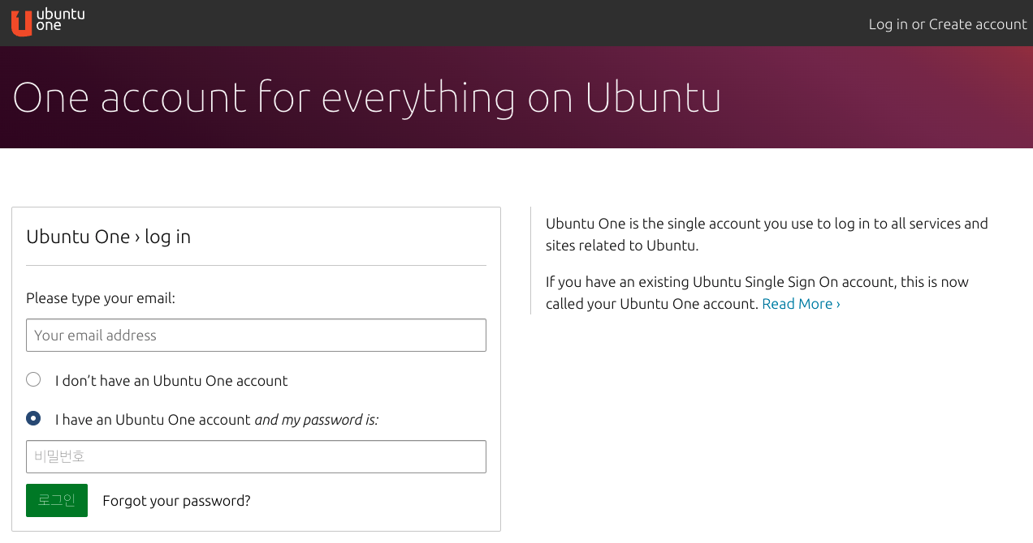
All of our journey begins with signing up for an ubuntu one account.
Click this to make your ubuntu one account
Reference :
https://login.ubuntu.com/

Slide 5
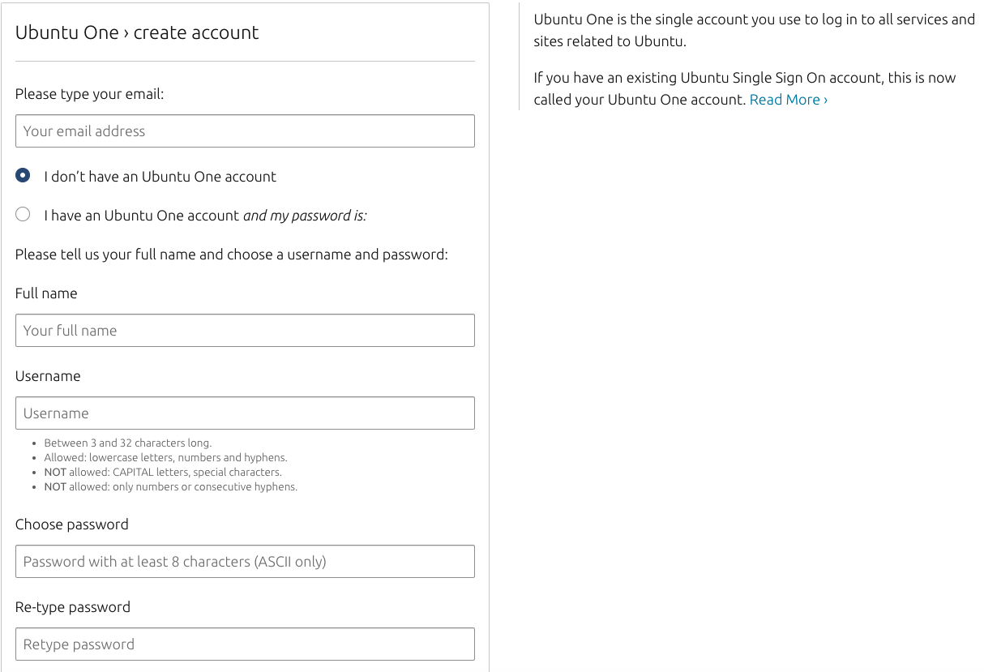


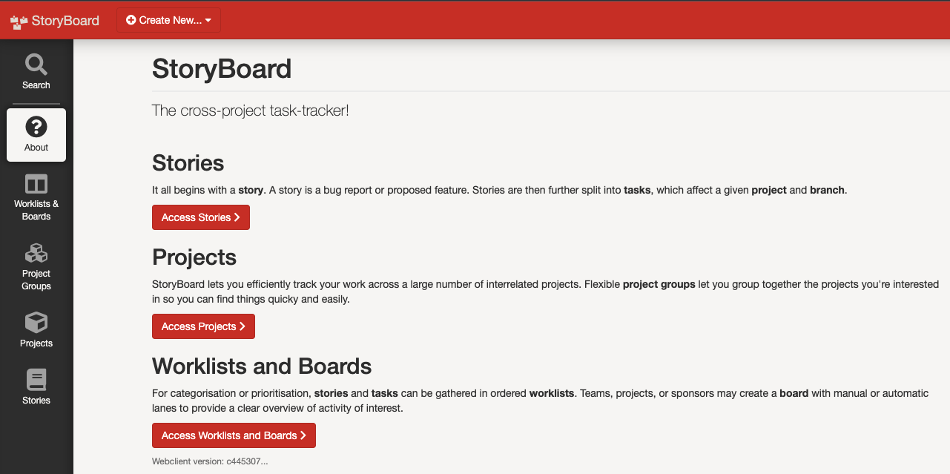
Fill the signup format and submit it!
You can use ubuntu one as an integrated account of gerrit & storyboard

Slide 6
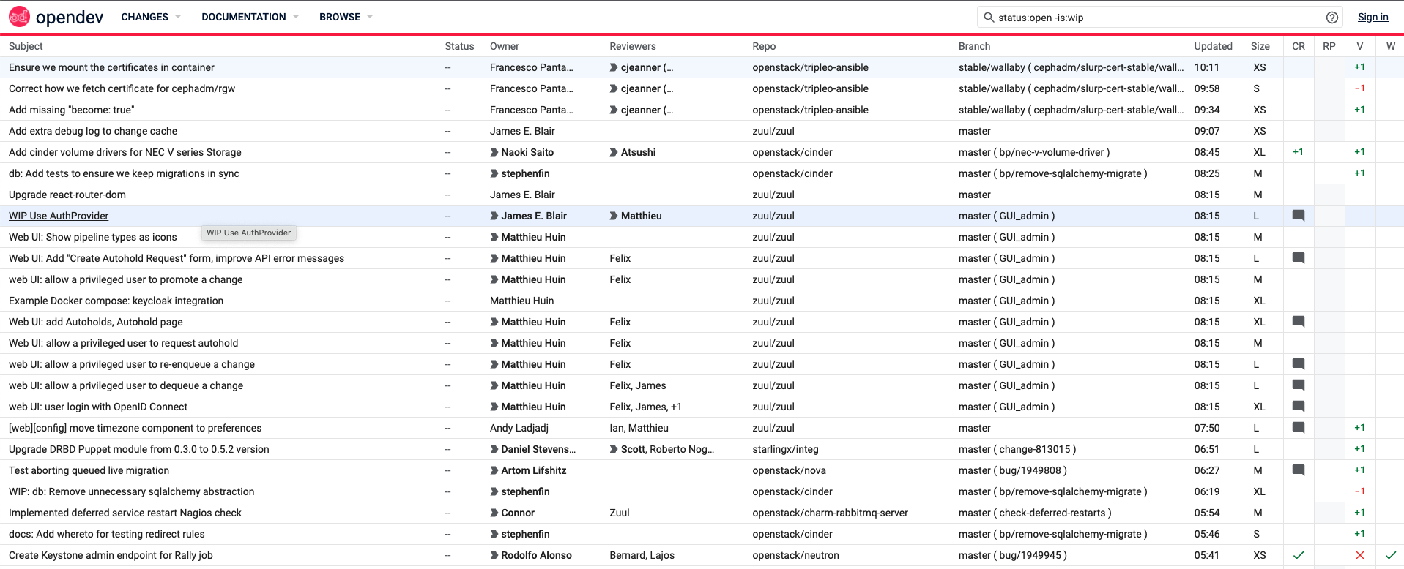
Gerrit
As a tool to commit & review to OpenStack, you can commit here the code that has been working on bug reports or functional improvement that you build.
you can receive code review scores from the mainainer based on git.
Reference :
https://review.opendev.org/

Slide 7
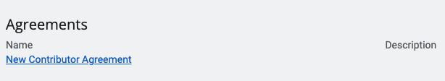
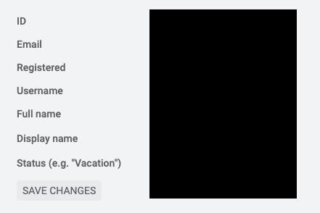
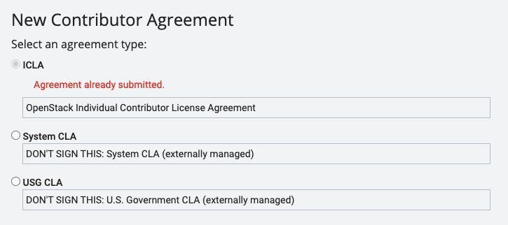
Gerrit Contributor Agreement
When you finish signing up for Gerrit with Ubuntu one, go to the setting page and click on the contributor agreement.
Click ICLA there, set username and full name in your profile (it is necessary to set the git review, so make sure to set it up)

Slide 8
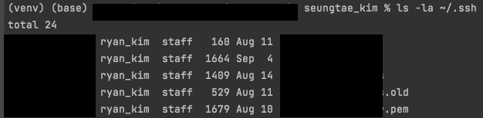
Create & Register your SSH Key
After creating an account, type out the command below at the desktop terminal to check the SSH key currently on your computer.
ls -la ~/.ssh
If you enter the command, you will get the SSH key you own as below, or if you don't have it, nothing will come out.
Create an SSH key to connect your terminal with your Gerrit account.
ssh-keygen -t rsa -b 4096 –C "your_email@example.com"
You can set the file name and password of the SSH key, but if you don't want to make custom settings, enter all the entities.
Enter a file in which to save the key (/Users/you/.ssh/id_rsa): [Press enter]
Enter passphrase (empty for no passphrase): [Type a passphrase] Enter same passphrase again: [Type passphrase again]

Slide 9
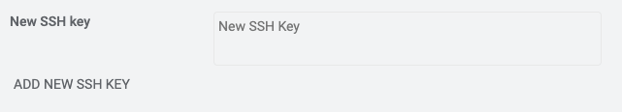
Create & Register your SSH Key
create config file using your terminal below the path
> vim ~/.ssh/config
Copy the text below and paste these into the config file
Host review.opendev.org review Hostname review.opendev.org Port 29418 User <your_gerrit_username> IdentityFile ~/.ssh/<your SSH Key File Name>
cat ~/.ssh/<your SSH key file.pub>
If you have set the text up, copy and paste the password value in SSH key file to “New SSH key box” at the bottom of your Gerrit account settings.
Reference :
https://docs.openstack.org/contributors/common/setup-gerrit.html

Slide 10
Storyboard
It is a tool that leaves bug messages or issues that need to be improved while using open stack, and it is possible to work in conjunction with gerrit.
Reference :
https://storyboard.openstack.org/

Slide 11
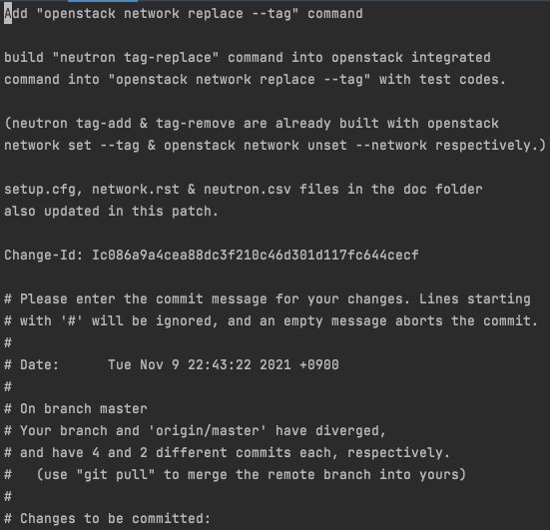
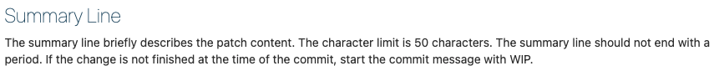
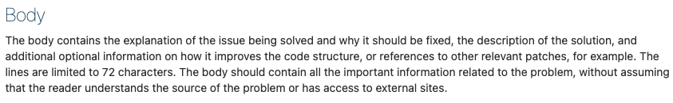
Commit Message Rule
Basic Commit message Format
All Commit message is written in compliance with the PEP8 rule.
Summary Line
Empty line
Body
Empty line
Footers
There are also rules for configuring commit messages.
Fill in the title → empty line → body contents what you worked on → empty line → footer content in order.

Slide 12
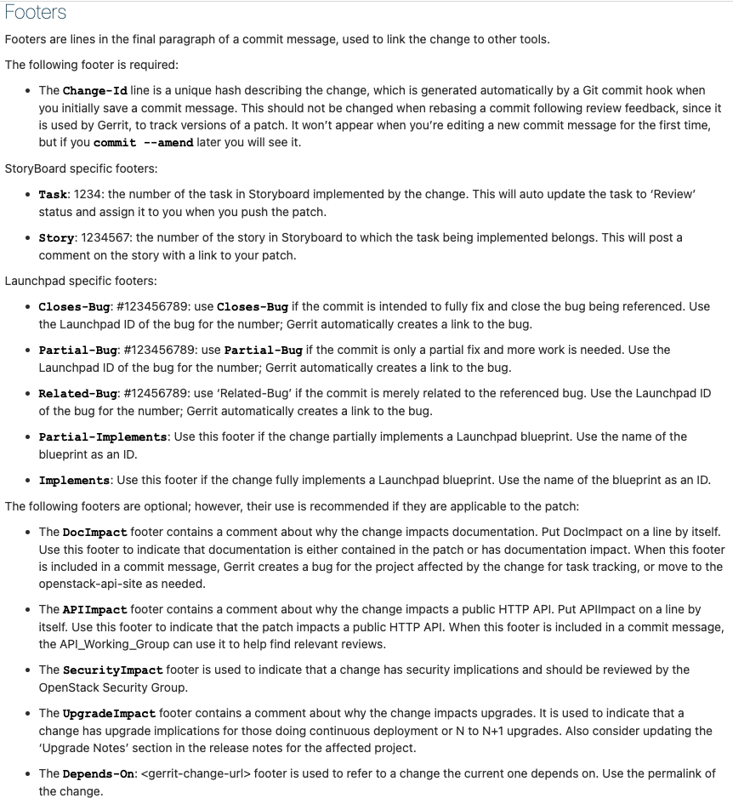
Commit Message Rule
Write additional content on Footer, such as story ID.
Change-Id is created automatically, so do not write it.

Slide 13
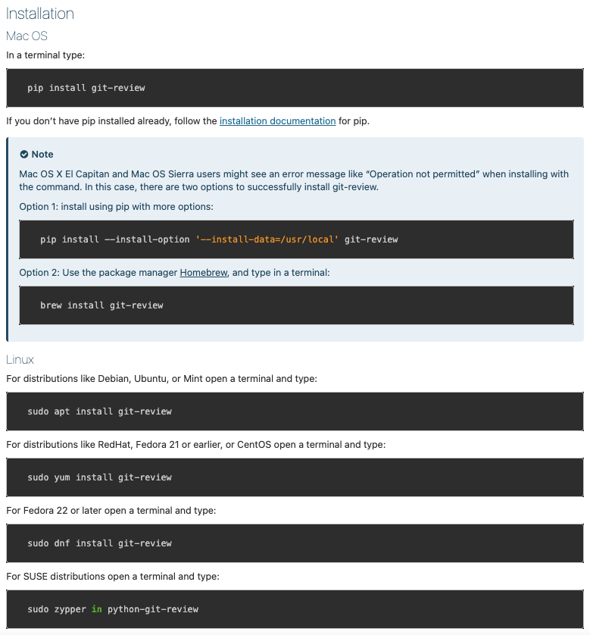
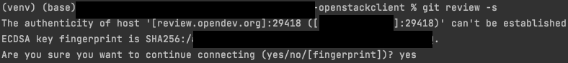
Git Review Setup
If you are using MacOS Sierra, you may see an errors, so refer to the settings below.
Let’s prepare a commit setup to Gerrit.
pip install git-review
Set your gitreview username at your local terminal.
git config — global — add gitreview.username “<your Gerrit Username>”
Run the following command on the path where you clone the OpenStack component:
git-review -s
If the SSH key you created is recognized, enter yes to complete the setting.

Slide 14
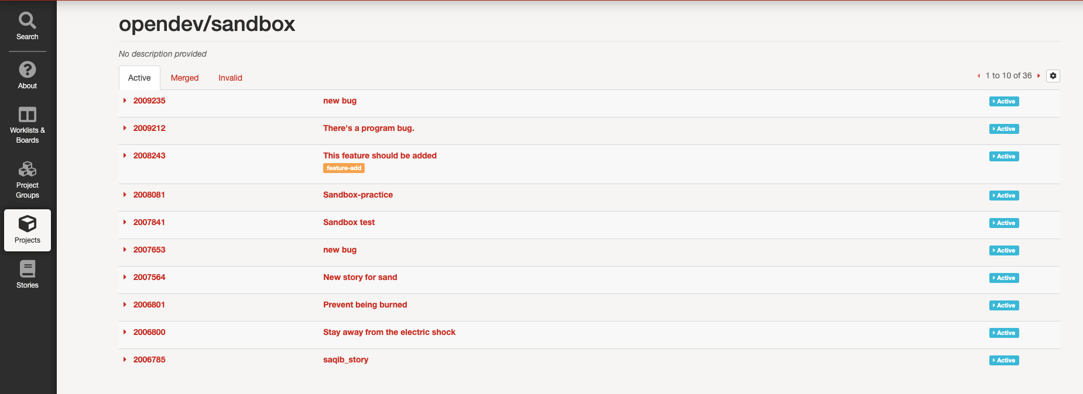
Storyboard & Sandbox Practice!
Let's practice the process of solving the bug on the storyboard and committing to Gerrit with a repository called Sandbox.
The Sandbox repo was created to work on code practice using Gerrit.

Slide 15
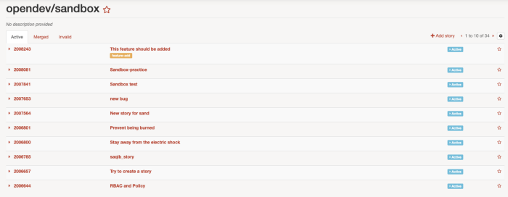
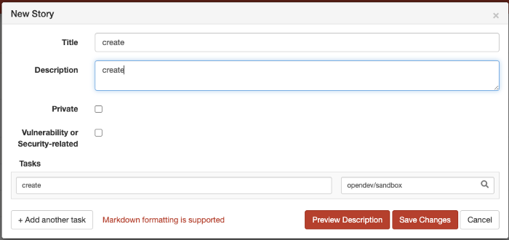
Storyboard & Sandbox Practice!
Click “Add story” and make an issue
Write the title and content of the issue, then click Save Changes.

Slide 16
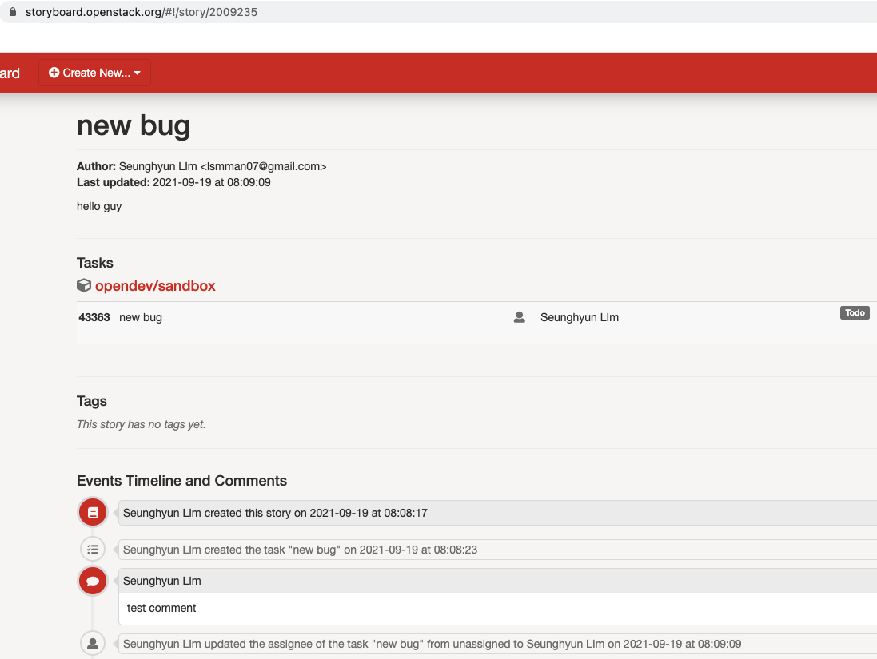
Check Story & Task ID!
Story ID
Check the issue you created, Story & Task ID.
If you can solve the bug yourself, (if the issue does not be created by your self) assign you in the story.
Task ID

Slide 17
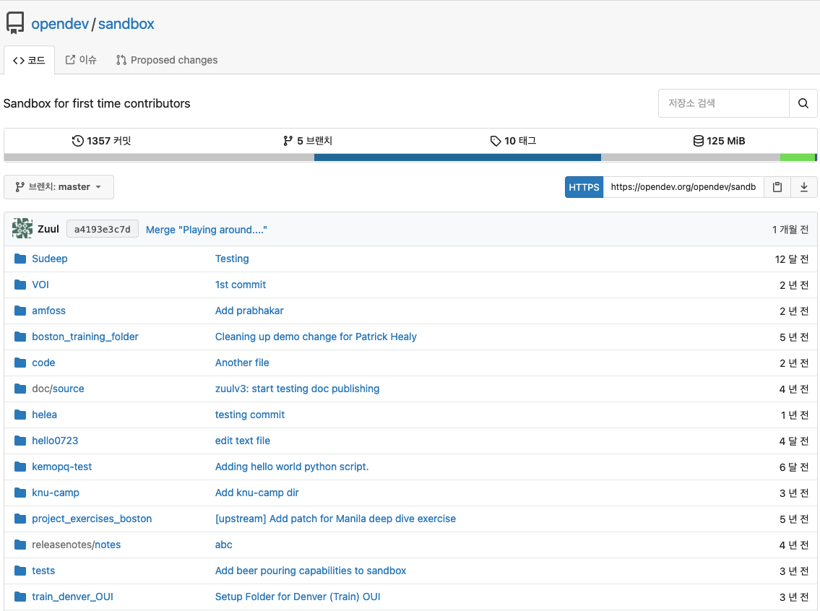
Clone Sandbox Project
Clone the Sandbox repository to resolve issues in Sandbox storyboard.
Reference :
https://opendev.org/opendev/sandbox

Slide 18
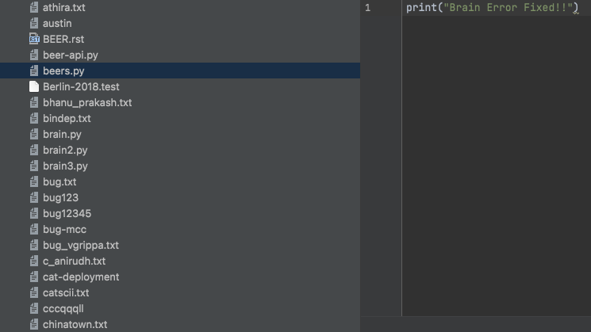
Sandbox Project
You can work on the file name in the form you want.
Please fill out the contents of the generated file as much as you want.

Slide 19
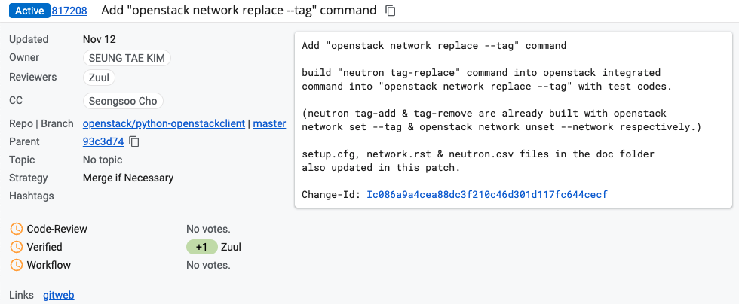
Remember the Commit Message Rule!
Commit messages written by your local terminal are displayed in the form of red boxes above in Gerrit.
When you complete the commit message, press “esc” and enter “:wq” to save the commit message and exit.

Slide 20
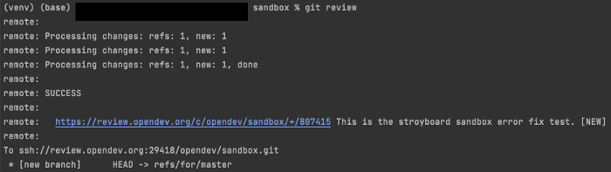
Push Your Commit
> git review
When the commit is completed, it is possible to check the link to the commit page.

Slide 21
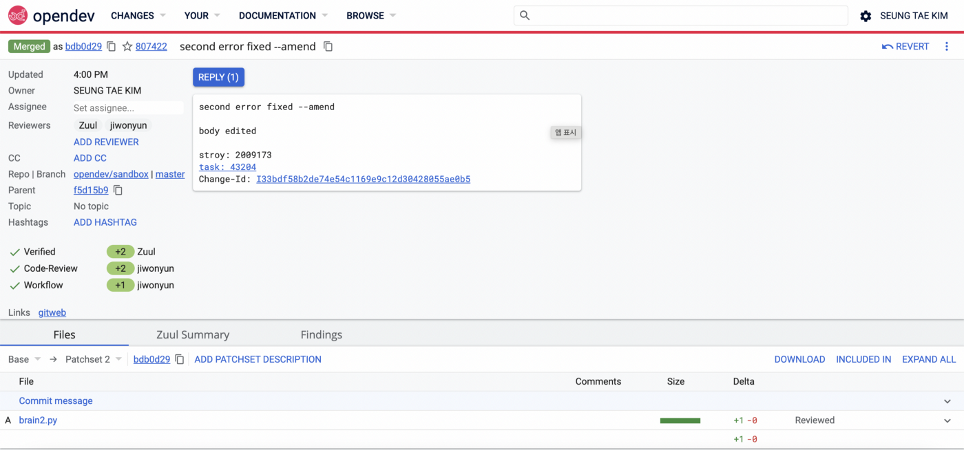
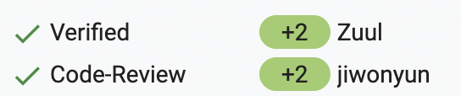

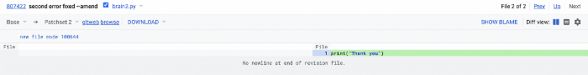
Review Your Code with Your Partner
Click and Leave a Comment
After reviewing, you can get code review scores from your partner as follows.
Leave a review of the uploaded commit in pairs.
check the review and modify the code according to the review.
(You can't review your code by yourself)

Slide 22
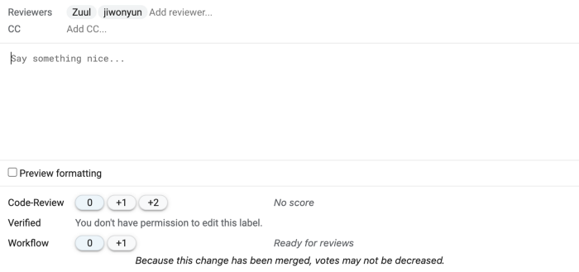
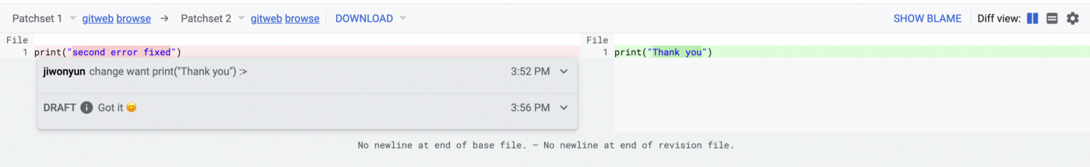
Review Your Partner’s Code
Review your partner's code and check the results!

Slide 23
Caution! Use “Commit --amend” After Review
After you get code review, there are precautions when updating a work piece.
It's not working with a “git commit” like the first commit.
Please use git commit --amend to modify and commit the existing commit message.
A new commit is used to create a code that is completely different from the existing results.

Slide 24
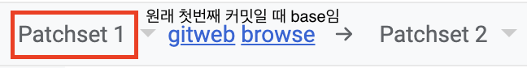
Caution! Change Patch
It is written as “base” at the first commit
Change the part that says Base at the top of the code review screen above to Patchset1, and when you complete code modification, let's mention that the code has been modified to the person who left the code review and press Done.
Then you can see that the person who left the review says patchset2 on the right side of the article (when you leave a review on the initial commit, it says patchset1) and the code is merged and closed by both gerrit and storyboard when the final approver gives the workflow score.

Slide 25
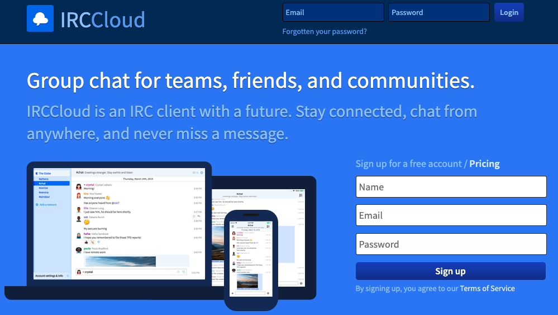
IRC & Mailing
IRC, or Internet Relay Chat, is often used as a real-time communication capability with open source projects.
If you have any questions about OpenStack to the maintainers, please proceed with the membership here and contact directly.
Reference :
https://www.irccloud.com/

Slide 26
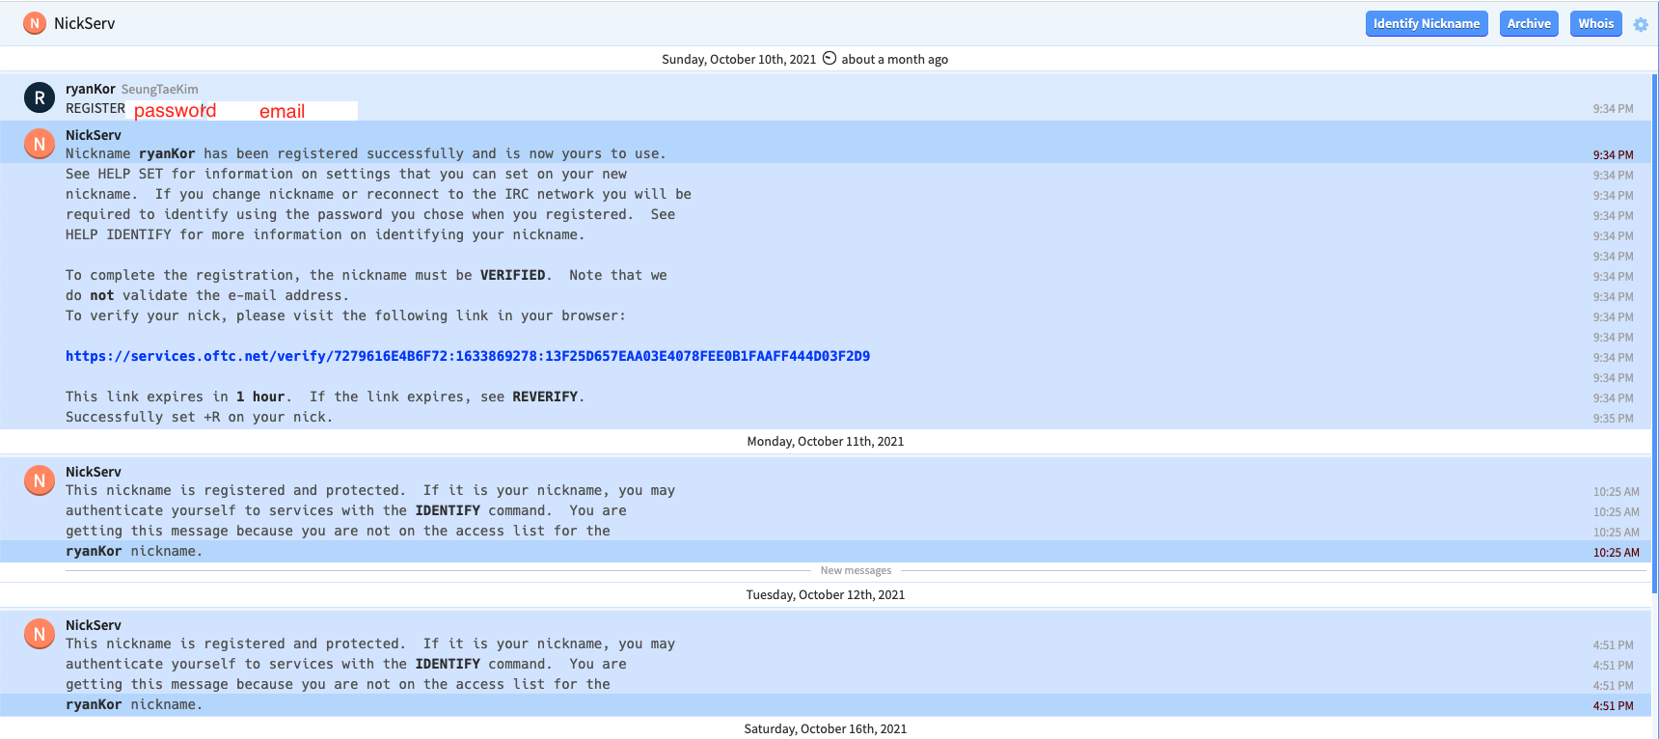
IRC Setup your account & Nickname
After signing up as a member, you proceed with account authentication.
You should authenticate your nickname on the #NickServ channel.
/msg NickServ REGISTER <password> <e-mail>
Registering your account, vertify your nickname according to the instructions in the channel.

Slide 27
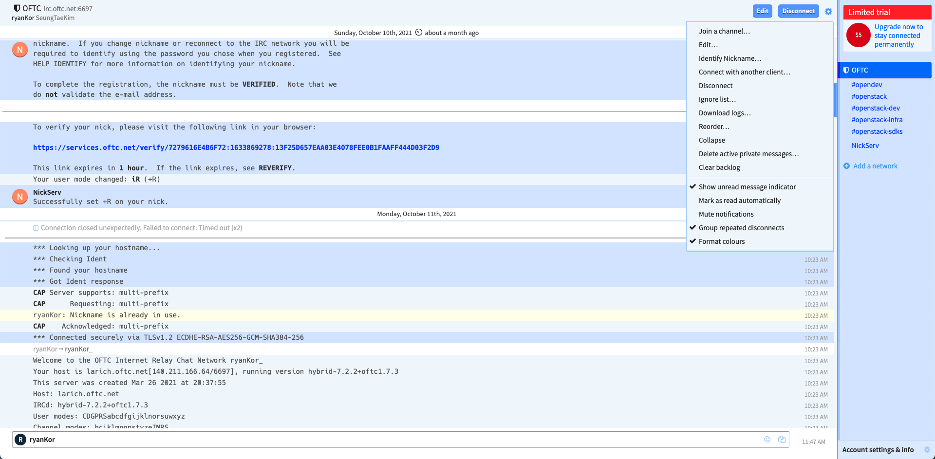
Join IRC Channel & Ask Questions with Maintainers
Click on the Join a channel to find an IRC channel where you can inquire about the project you are working on.
Refer to the link at the bottom to see the all channels.
Reference :
https://meetings.opendev.org/irclogs/

Slide 28
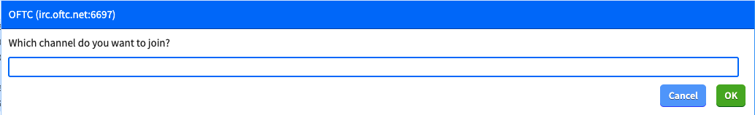
Join IRC Channel & Ask Questions with Maintainers
After entering the channel you are looking for as input, click ok to enter the channel!

Slide 29
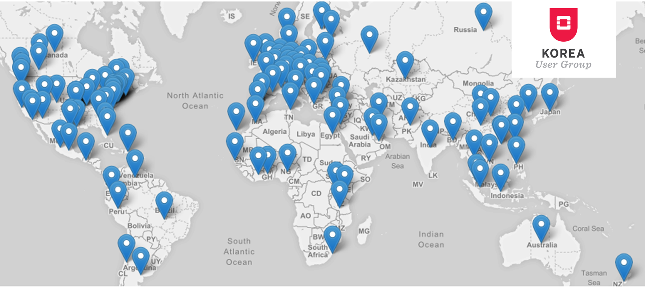
Thank you!
openstack.kr
http://www.openstack.or.kr
http://bit.ly/openstack-kr-videos

